Slide 1
AI-Powered Legal Documentation Assistant
PIP104 University Project-II
Review-1
Batch Number: CAI-G04
Roll Number | Student Name
20211CAIOO76 | E BHAVANI
20211CAI0064 | S SANJANA
20211CAI0065 | SIRI HG
20211CAI0174 | MOULYA HM
Under the Supervision of,
Dr. Swathi Sharma
Associate Professor-Selection Grade
School of Computer Science & Engineering
Presidency University
Name of the Program: Bachelor of Technology
Name of the HoD: Dr. Zafar Ali Khan N
Name of the Program Project Coordinator: Dr. Afroz Pasha
Name of the School Project Coordinators: Dr. Sampath A K / Dr. Abdul Khadar A / Mr. Md Ziaur Rahman

Slide 2
Introduction
The AI-Powered Legal Documentation Assistant is an advanced tool designed to simplify and automate the process of drafting, reviewing, and managing legal documents.
It leverages cutting-edge Natural Language Processing (NLP) and Machine Learning (ML) algorithms to assist legal professionals in efficiently handling complex legal texts.
The tool automates contract drafting, clause analysis, and compliance verification, ensuring that documents align with legal standards and best practices. By minimizing manual effort, it reduces the risk of human errors and enhances the accuracy of legal documentation.
This AI-driven solution significantly improves workflow efficiency, allowing lawyers, law firms, and corporate legal departments to focus on critical legal tasks rather than repetitive documentation processes.
Ultimately, it enhances productivity, streamlines legal operations, and ensures that legal documents are prepared with speed, precision, and compliance.

Slide 3
Literature Review

Slide 4
Proposed Method
The system utilizes Natural Language Processing (NLP) to analyze legal terminologies, clauses, and document structures, ensuring accurate understanding and processing of legal texts. This helps in identifying key legal entities such as parties, obligations, and deadlines.
It automates document generation by providing AI-driven templates for contracts, agreements, and other legal paperwork. Users can input key details, and the system will generate a structured legal document while maintaining accuracy and compliance.
An intelligent search and retrieval system allows users to quickly find relevant legal documents, case laws, and contract clauses. This is powered by semantic search and similarity-based retrieval methods, making legal research more efficient.
Machine learning models analyze past legal documents and cases to predict potential legal risks and suggest optimizations in contract terms. This proactive approach helps in minimizing legal vulnerabilities and enhancing document quality.
The system integrates with legal databases and APIs, ensuring that legal documents remain updated with the latest laws, regulations, and compliance requirements. This reduces the risk of outdated or incorrect legal information.
Secure document handling is implemented through encryption techniques and access control mechanisms to ensure confidentiality and data privacy. This safeguards sensitive legal information from unauthorized access and cyber threats.

Slide 5
Objectives
Automate Legal Document Generation – Develop an AI-driven system to create legal documents efficiently, reducing manual effort and human errors.
Enhance Accuracy and Compliance – Implement NLP and ML models to analyze legal clauses, ensuring documents adhere to regulatory standards and legal best practices.
Improve Legal Document Accessibility – Provide language simplification and summarization features to make complex legal texts easier to understand for professionals and clients.
Enable Intelligent Search and Analysis – Develop a smart search system to retrieve relevant legal documents, case references, and contract clauses quickly and accurately.
Ensure Security and Confidentiality – Implement encryption and access control measures to protect sensitive legal information from unauthorized access and cyber threats.

Slide 6





Methodology
Planning & Requirement Analysis
System Design & Architecture
Model Development & Implementation
Testing & Validation
Deployment & Maintenance

Slide 7
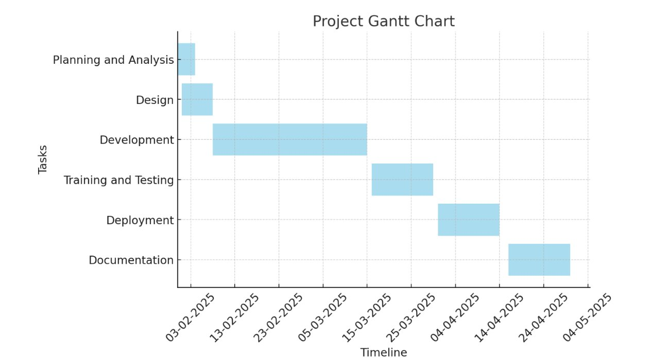
Timeline of Project

Slide 8
Expected Outcomes
Automated Legal Document Generation – Reduction in manual effort through AI-driven contract and agreement drafting.
Enhanced Accuracy & Compliance – Improved legal document quality with AI-powered clause analysis and risk detection.
Time & Cost Efficiency – Faster legal documentation processes, reducing turnaround time and operational costs.
Improved Accessibility & Understanding – Simplified legal language and AI-generated summaries for better comprehension.
Secure & Efficient Document Management – Encrypted storage, role-based access, and seamless integration with legal databases.

Slide 9
Conclusion
The AI-Powered Legal Documentation Assistant automates the drafting, review, and compliance verification of legal documents using advanced Artificial Intelligence (AI) and Natural Language Processing (NLP) techniques. This reduces the dependency on manual work and speeds up the document creation process.
The platform provides an intelligent search and risk assessment feature, enabling users to quickly retrieve relevant legal documents, contract clauses, and case laws. Additionally, AI-powered risk detection highlights potential legal pitfalls, missing clauses, or inconsistencies.
Secure document management is ensured through encryption and role-based access control, protecting sensitive legal information from unauthorized access and cyber threats. The system maintains compliance with industry security standards for data protection.
Overall, the AI-powered solution improves efficiency by streamlining legal documentation processes, making them faster, more reliable, and cost-effective. It empowers legal professionals to focus on critical decision-making rather than spending excessive time on repetitive tasks.

Slide 10
References

Slide 11
Thank You

